Slide 1


UX for Games
I’ve been working on 4 titles to the moment. 2 of them are live
The Household (live) Classic farm game with content updates.
World Pocker Club (live) The most popular social poker in Russia and the CIS
MMO RTS (TBA) Travian like game for small screens.
Bottle. Find your Love(TBA) Classic bottle game with kisses. Based on hyper-popular Russian reality show franchise: Dom 2 (“Дом 2”)

Slide 2
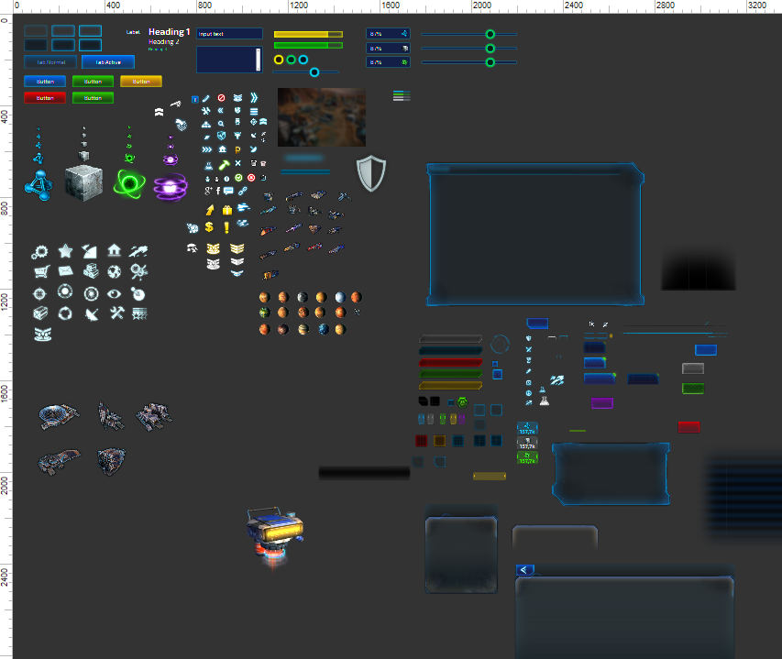
MMO Strategy (not yet shipped)
Overview: I’m leading a team: GD + Unity Lead + outsource production (6 people). Also I do all UX & UI an the project.
To the moment there are 100+ screens and states done.
I can show only few, that has already gone public.
Promo & community website:
www.stellarage.com

Slide 3
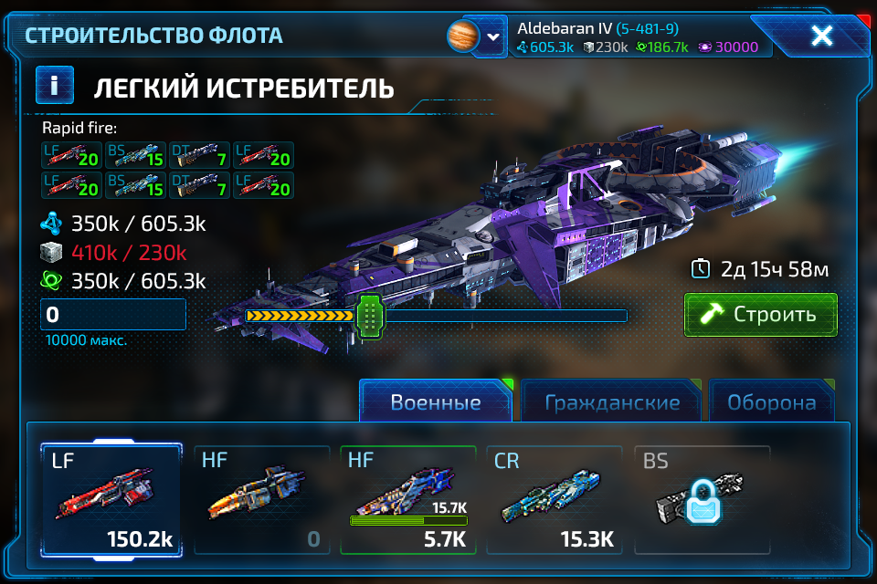
MMO Strategy (not yet shipped)
Task: Build troops flow.
Solution:
First approach http://artfabrique.github.io/cv/portfolio/SA/FleetBuild/start.html
Design (on the right)

Slide 4
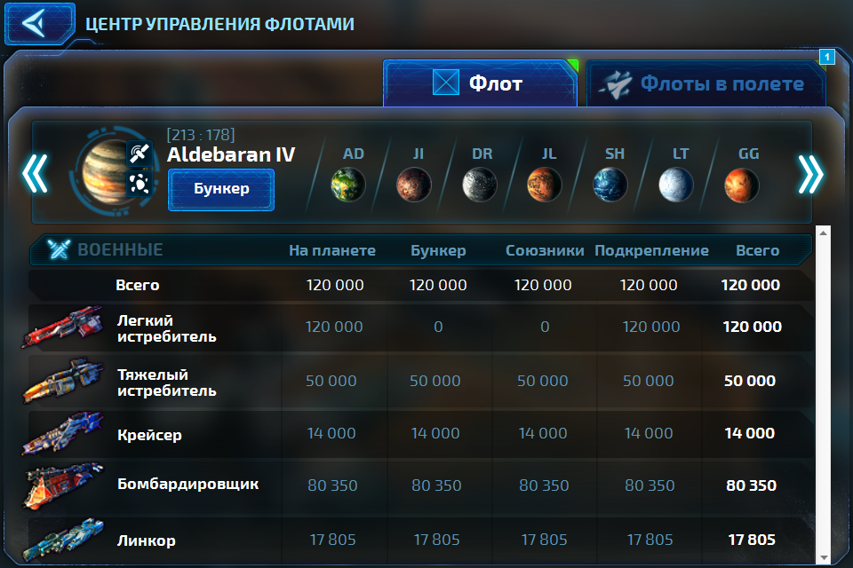
MMO Strategy (not yet shipped)
Task: Mission Control Center.
Lets user overview his fleet on different planets.
Lets user to put fleet in Interdimensional bunker, a bubble in time/space supporter by fuel that ships take with them as a cargo.
Solution:
http://artfabrique.github.io/cv/portfolio/SA/MCC/start.html

Slide 5
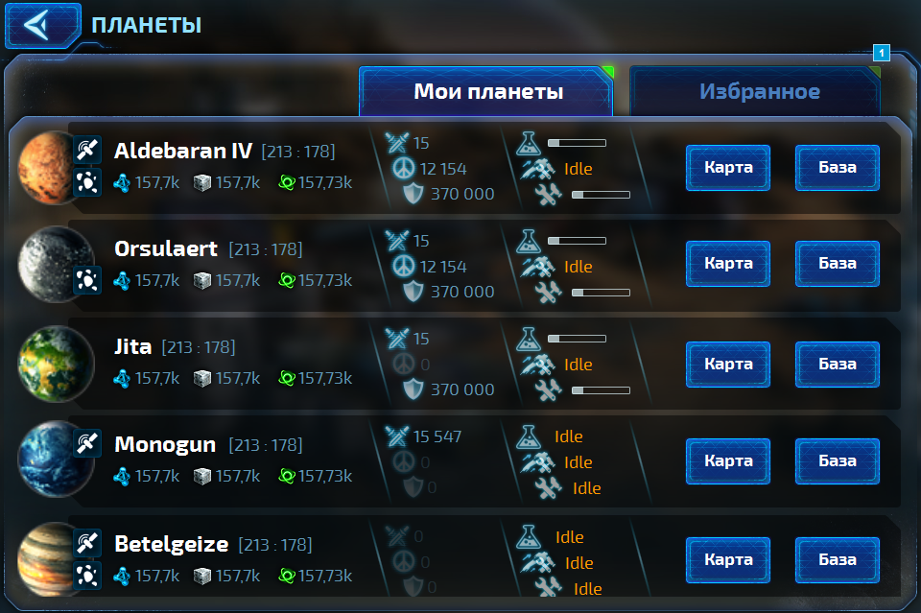
MMO Strategy (not yet shipped)
Task: Planets dashboard.
Lets user overview status of all planets.
Motivate user to build-up bases & might. Nothing should be idle.
Solution:
http://artfabrique.github.io/cv/portfolio/SA/Planets/start.html

Slide 6
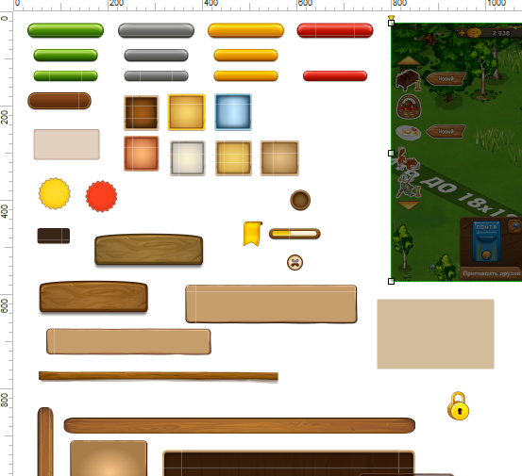
The Household
Overview: Special UI pack of common elements was done in Axure for more precise prototyping.
I have successfully designed UX & UI of 20+ new game-mechanics modules.
Workflow:
Functional requirements doc.
“Box” prototype to organize userflows and break information into layers.
UI prototype to organize information weights (tone/color accents)
Special art preparation (backgrounds, decorative elements)
Implementation
https://apps.facebook.com/playhousehold

Slide 7
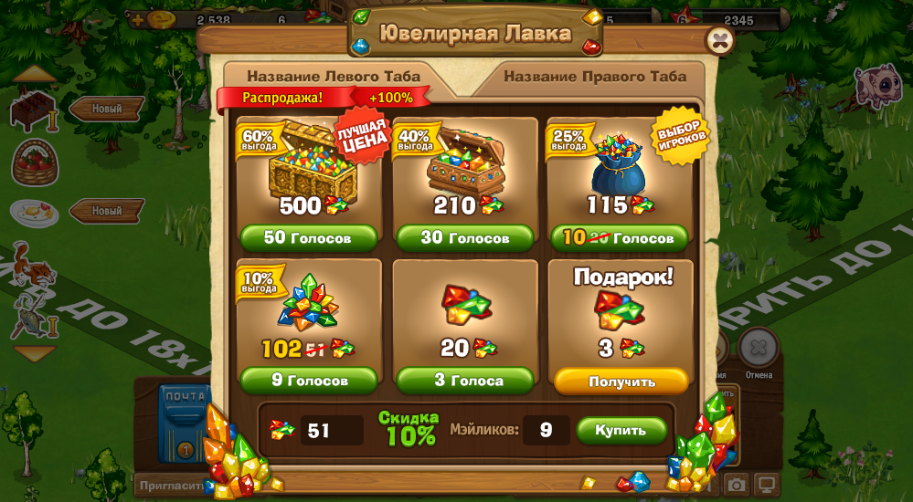
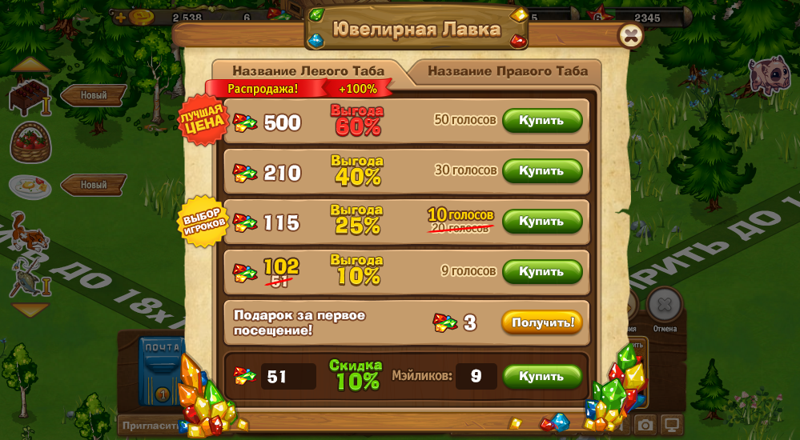
The Household
Task: Refresh “Bank” window design. Improve accent on discounts.
Solution:
Make two variants of layout (“6-pack” & “ladder”) and test both on new-comers vs high-level players.
Add additional discount marker for top-profit SKU
Result: “6-pack” design performed better for new-comers, but “ladder” was loved by the core audience. Both designs performed better than the old one.

Slide 8
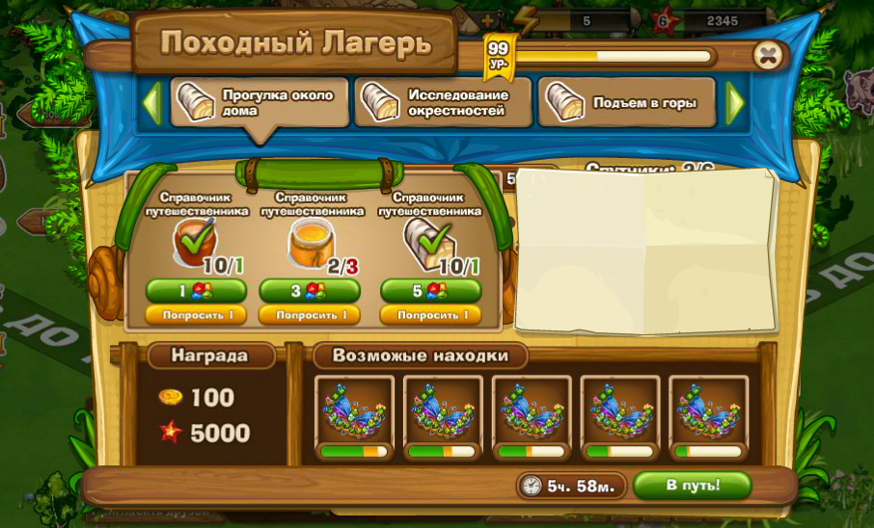
The Household
Task: Design “Hiking Camp” mechanics. User buys a landmark. Each landmark represents destination of journey. The output is:
Gold & Exp. (100% chance)
Prem. item (<100% chance)
Users can ask friends to join their journey. Each friend increases chances of finding premium items.
Solution:
Progress bar with 2-colored threshold to show chance w/wo friends.

Slide 9
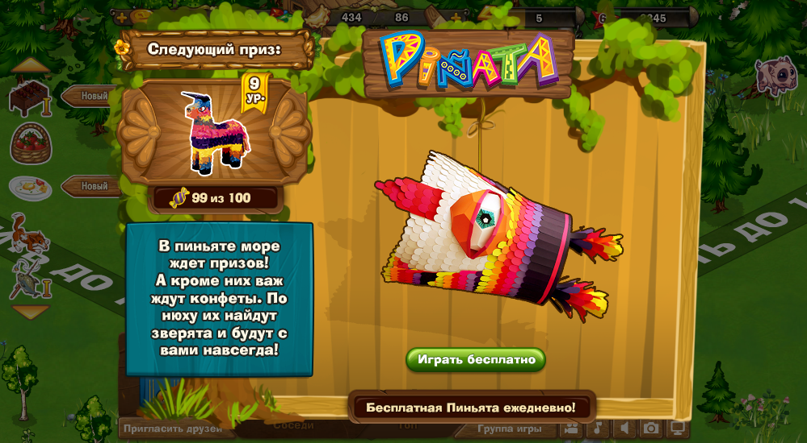
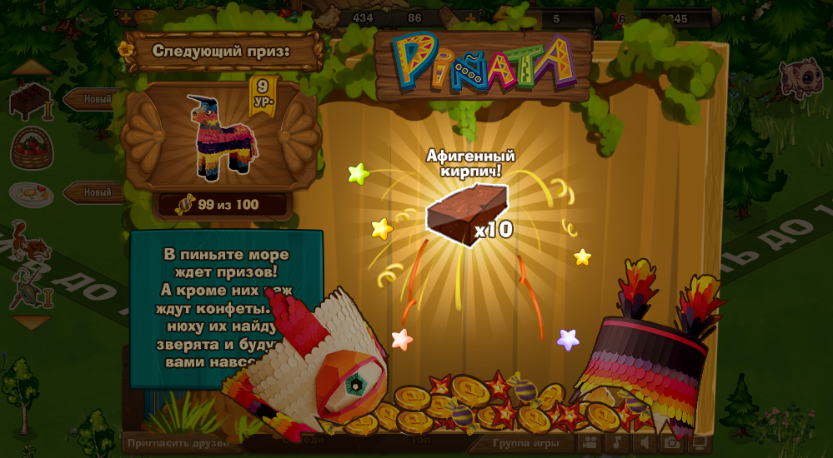
The Household
Task: Create gambling mechanics with single prize per roll. Each player has own prize pool.
Solution:
“Peñate” idea.
Peñate

Slide 10
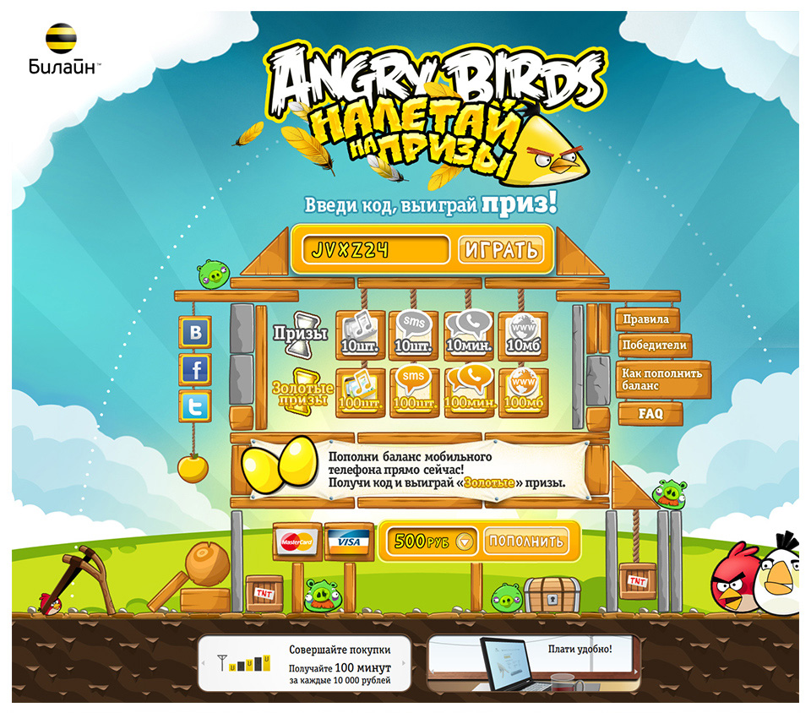
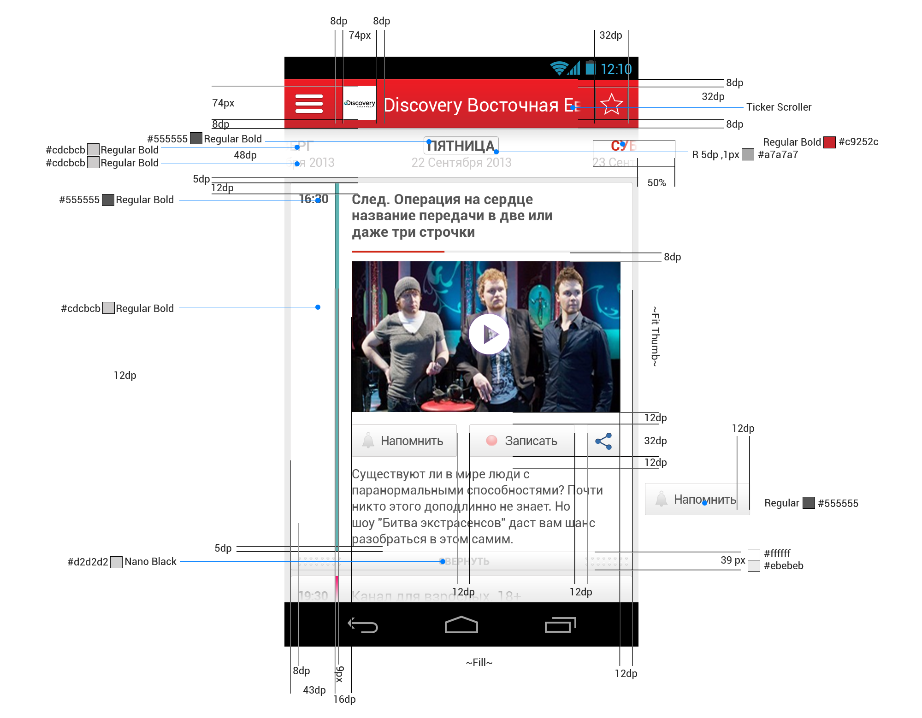
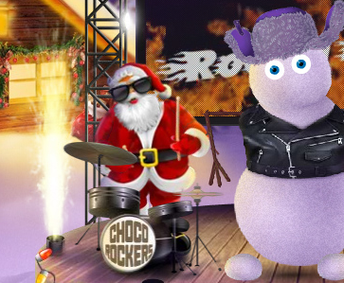
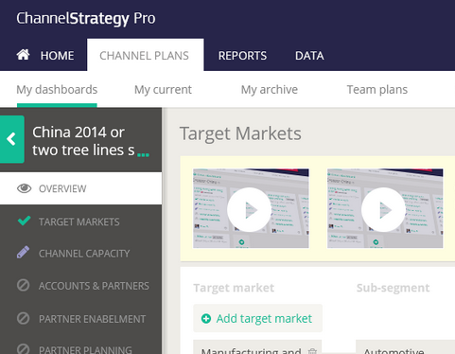
UX for Business
I’ve completed over 40 interactive promo projects for world-wide brands as a Digital Art Director and later as a Digital Creative Director.
My favorite brands, I worked with:
IBM
Kraft Foods
Milka
AlpenGold
British American Tobacco
Beeline (Russian telecom #1)
Procter & Gamble
Always
CTI (Interactive TV, mobile+ set-top box)

Slide 11
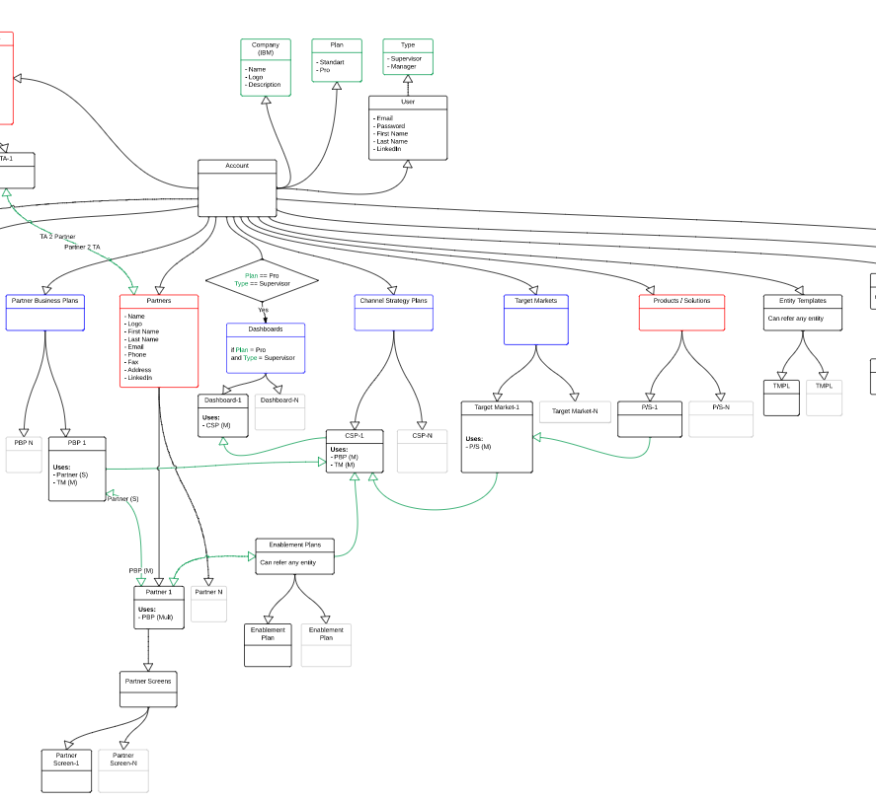
Channel Strategy Pro
Product: Online cloud tool to ease the regional sales process. For a company like IBM that has no interest in direct sales, but channel sales/vendor contracts, this tool became #1 weapon of regional sales man.
Before it was done by filling in huge 50-paged Excel file.
What I have done:
Separated Excel-fill-in flow into several use cases based on user roles: Channel Manager/Director
Redone data relationship scheme
Applied use-cases to data relationship scheme.
Prototype
Design.

Slide 12
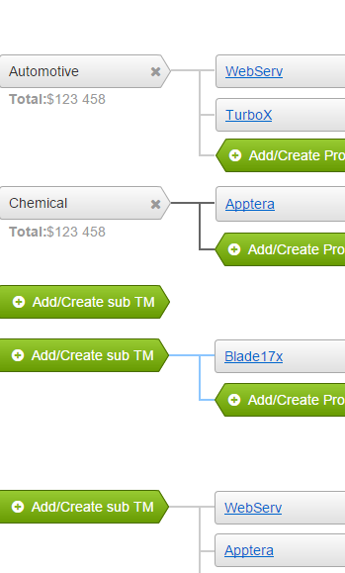
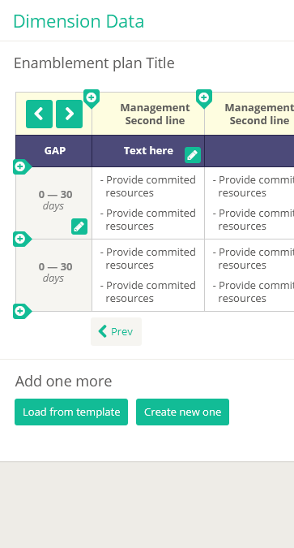
Channel Strategy Pro
Fist iteration prototype: http://yg1osz.axshare.com/#p=home
UI Design: http://qtgas3.axshare.com/#p=home
Data Scheme https://www.dropbox.com/s/w3wkgywghs0r79g/CSPro%20-%20DB%20v6.pdf?dl=0

Slide 13
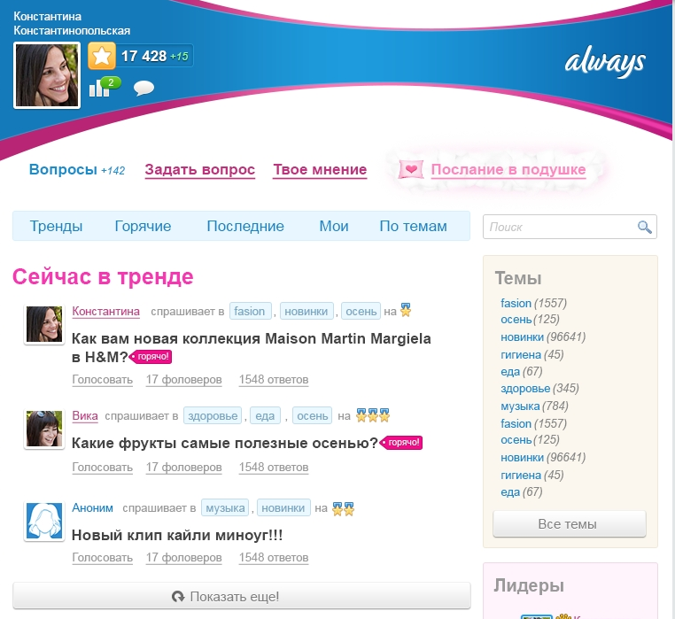
Always Social Hub
Product: Online hub for women inside a top Russian social network OK.ru
Features:
Social Q&A with ratings
Product information
Promo sections
Prototype:
http://artfabrique.github.io/cv/portfolio/Always/Hub/start.html
Source:
https://dl.dropbox.com/s/5ztaurcq49yxkf5/alwaysSocialPlatform.rp

Slide 14
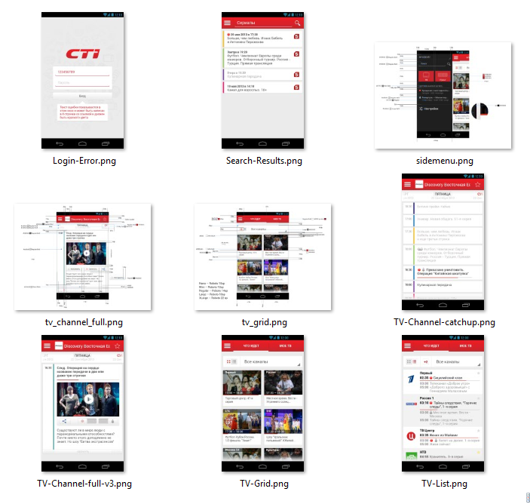
CTI
Product: Interactive TV connected to the mobile app. (multiscreen app)
Features:
TV schedule
Interactive TV context on mobile companion app.
Reminders and remote record of any show.
Live streaming to mobile.
I’ve developed:
User Flows based on time of the day, gender & method of transportation.
UI Design.

Slide 15
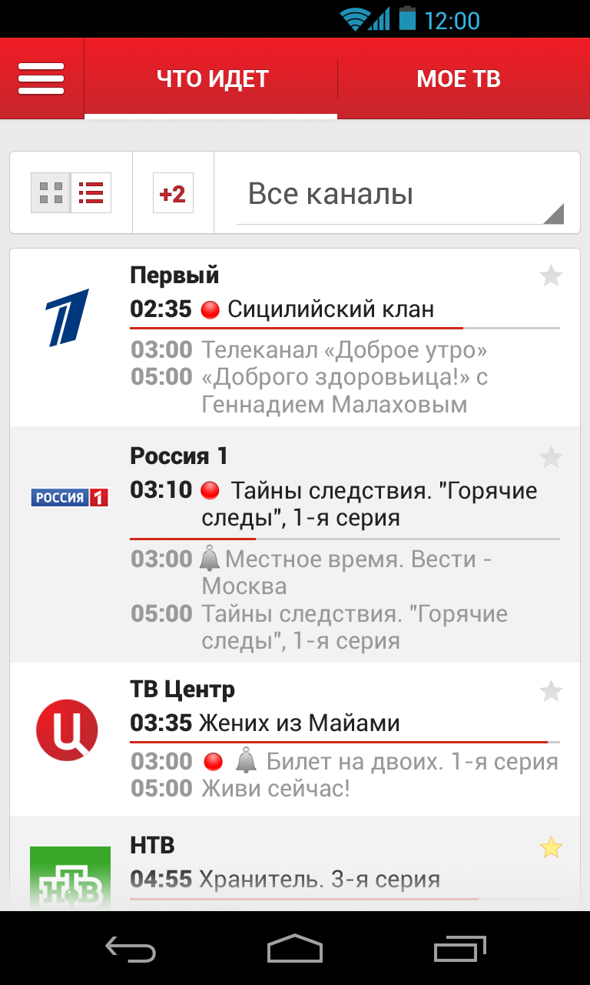
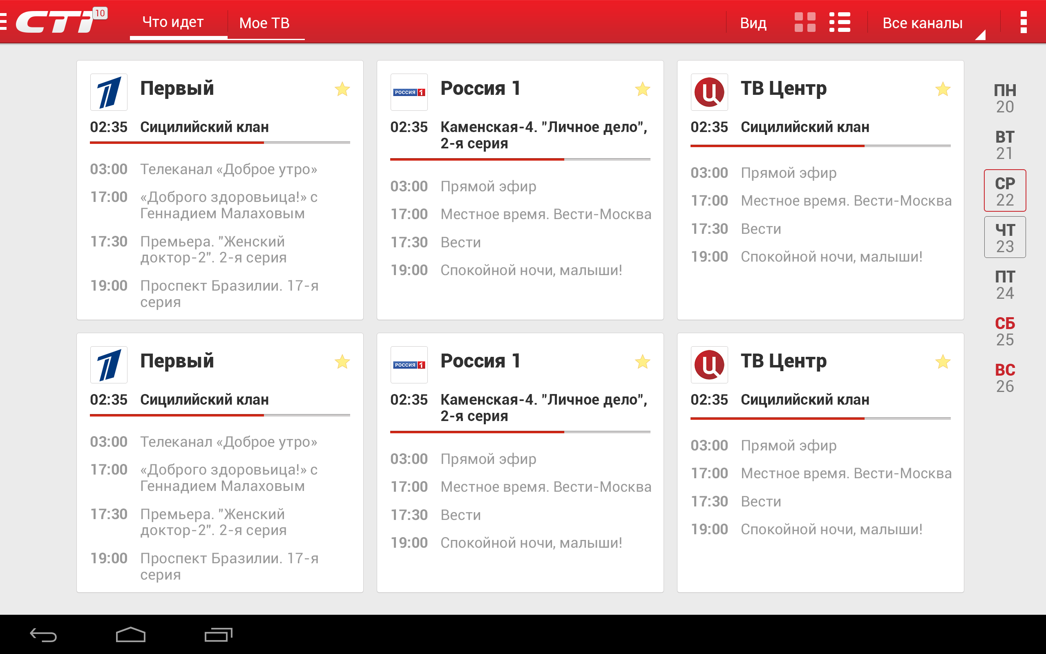
CTI

Slide 16
Beeline
Product: Top-up promo with Angry Birds
Overview:
User makes top-up
User receives 1-10 lives in a special branded level of AB
User launches a birds trying to hit the prizes
Free minutes packs
Free data packs
Free sms packs

Slide 17
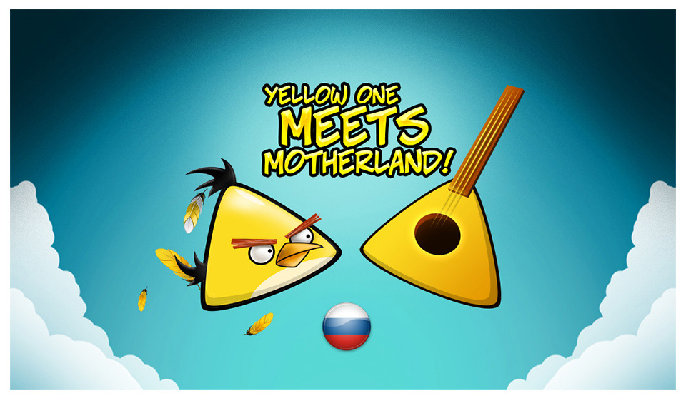
Beeline
I’ve proposed an idea about yellow Bird who is triangular because he grew up in Balalaika (national music instrument). Now his brother is in danger and all the birds company arrives Russia to save him.

Slide 18
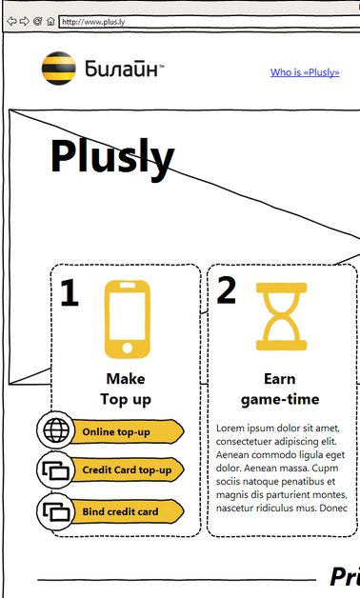
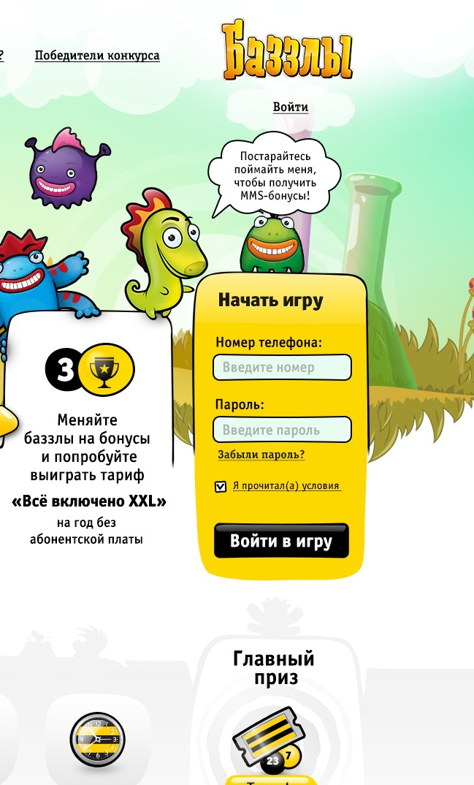
Beeline
Project: Plusly. Top-up motivation platform with gamification.
http://artfabrique.github.io/cv/portfolio/Beeline/Beeline_proto_v2.html
Overview:
User makes top-up
User receives token for 5-10 seconds of gameplay
User plays a game and tryes to catch all bonuses
When time runs out user gets all the rewards that he scored.
Free minutes packs
Free data packs
Free sms packs

Slide 19
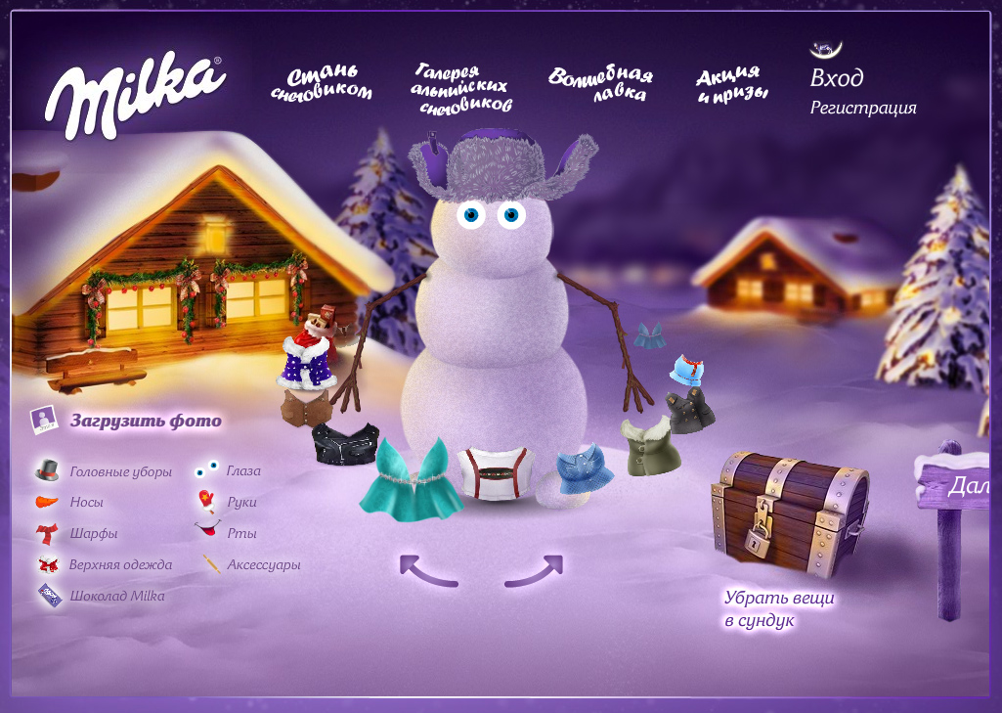
Milka
Product: Promo website with UGC.
http://www.youtube.com/watch?v=-uza8kPGwjI
Features:
Create a snowman
Dress him up
Share with friends & download desktop snowball widget
I’ve developed:
All design & illustrations
All client-side code (AS3)
This project and idea of virtual Alpine Village became a platform for brand communication for 3 years.
In 2009 Ogilvy & Mather grabbed gold award at EFFIE in “Digital” nomination.

